Slide 1
Supporting and Enhancing Mathematics and Statistics
UNIT: Units of Measurement

Slide 2
UNIT:
Units of Measurement
Units of Measurement
Units of Measurement and their application are essential in all branches of the sciences.
You have four sections to work through and there are check up audits through fitness tests for each section.
Units and Measuring
Upper and Lower Bounds
Estimating Areas
Conversion of Units

Slide 3
UNIT:
Units of Measurement
Units and Measuring
Different units of measurement can be used to measure the same quantities. It is important to use sensible units. Some important units are listed below.
Quantity | Units of Measurement
Length | 1 km = 1000 m 1 m = 100 cm 1 m = 1000 mm 1 cm = 10 mm
Weight | 1 tonne = 1000 kg 1 kg = 1000 g
Volume/Capacity | 1 litre = 1000 ml 1 m³ = 1000 litres 1 cm³ = 1 ml

Slide 4
UNIT:
Units of Measurement
Section 1
Units and Measuring: Examples
Example 1
What would be the best units to use when measuring,
the distance between London and Plymouth
(b) the width of a watch-face
(c) the mass of a person
(d) the mass of a letter
(e) the mass of a lorry
(f) the volume of medicine in a spoon
(g) the volume of water in a swimming pool
Solutions
km (or miles)
mm or cm
(c) kg
(d) grams
(e) tonnes
(f) ml
(g) m³

Slide 5
UNIT:
Units of Measurement
Section 1
Units and Measuring: Examples
Example 2
How many mm are there in 3.72 m?
(b) How many cm are there in 4.23 m?
(c) How many m are there in 102.5 km?
(d) How many kg are there in 4.32 tonnes?
1 m = 1000 mm; so 3.72 m = 3.72 × 1000 = 3720 mm
1 m = 100 cm; so 4.23m = 4.23 × 100 = 423 cm
1 km = 1000 m; so 102.5 km = 102.5 × 1000 = 102 500 m
1 tonne = 1000 kg; so 4.32 tonnes = 4.32 × 1000 = 4320 kg

Slide 6



UNIT:
Units of Measurement
Section 1
Units and Measuring: Examples
Example 3
What value does each arrow point to?
(b)
(c)
Here the marks are 0.1 units apart.
So the arrow points to 12.6.
Here the marks are 0.2 units apart.
So the arrow points to 11.8.
Here the marks are 0.4 units apart.
So the arrow points to 6.8.

Slide 7
UNIT:
Units of Measurement
Section 1
Section 1: Fitness Check
Here are some questions to check your progress;
there are more practice questions if needed.
Which units do you think would be the most suitable to use when measuring:
(a) the distance between two towns
(b) the length of a sheet of paper
(c) the mass of a sheet of paper
(d) the mass of a sack of cement
(e) the volume of a water in a cup
(f) the volume of water in a large tank
Answers
(a) km or miles
(b) cm
(c) mg or grams
(d) kg
(e) ml
(f) m³ or litres

Slide 8
UNIT:
Units of Measurement
Section 1
Measurement Section 1: Fitness Check
2) Complete the missing quantities in this table
Length in m | Length in cm | Length in mm
4
 | 311
 |  | 1500
 | 374
8.62
400 4000
3.11 3110
1.5 150
3.74 3740
862 8620

Slide 9
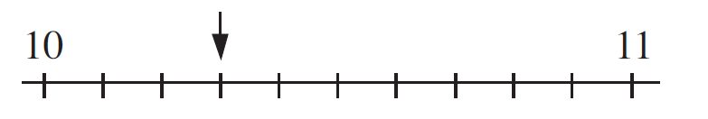


UNIT:
Units of Measurement
Section 1
Measurement Section 1: Fitness Check
3. What value does each arrow point to?
(a)
(b)
(c)
10.3
130
6.6

Slide 10
UNIT:
Units of Measurement
Section 1
Section 1: Review
You have completed the first Section.
If you have completed and understood this section,
click to start the next Section
If you need more examples and interactive practice,
press here
You might also find it helpful to look at:
Essential Information: press here

Slide 11
UNIT:
Units of Measurement
Section 2
Upper and Lower Bounds
When measurements are made, they can only be obtained to a limited degree of accuracy.
For example if the length of a line is given as 11 mm, this means that it
is 11 mm to the nearest mm.
This means, for example, that the original measurement could have
been 11.3, as 11.3 would round to 11; but the original measurement
could also have had a value like 10.6, as 10.6 would also round to 11. There are many values that the original measurement could have taken.
In fact, if l is the length of 11 mm then it must lie in the range
10.5 ≤ l < 11.5
This just says that the length can be anything between 10.5 and 11.5 mm.

Slide 12
UNIT:
Units of Measurement
Section 2
Upper and Lower Bounds: Examples
For each length below state the range of values within which the length must be.
18 cm
12.7 cm
11.06 m
17.5 ≤ l < 18.5
12.65 ≤ l < 12.75
11.055 ≤ l < 11.065

Slide 13
UNIT:
Units of Measurement
Section 2
Upper and Lower Bounds: Note
The lower bound is the smallest number which will round to the given number, while the upper bound is the smallest number which will not round to the given number.
So in the previous example, for 18 cm
17.5 ≤ l < 18.5
and the lower bound is 17.5 cm
while the upper bound is 18.5 cm.

Slide 14
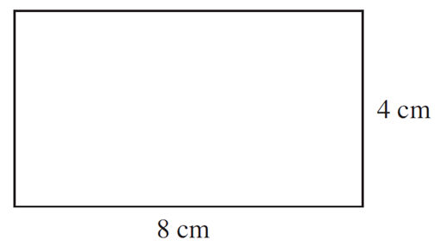
UNIT:
Units of Measurement
Section 2
Upper and Lower Bounds: Example
If the length of the sides of the rectangle
below are given to the nearest cm, find:
a) The minimum possible perimeter.
First note that the length, l, of the rectangle is 8 cm to the nearest cm,
so 7.5 cm ≤ l < 8.5 cm
Similarly for w to the nearest cm, 3.5 cm ≤ w < 4.5 cm
To find the minimum possible perimeter, we use the minimum length and widths, giving:
Minimum perimeter = 7.5 + 3.5 + 7.5 + 3.5 = 22 cm
b) The range of possible areas.
We use the maximum and minimum lengths of each side.
Minimum area = 3.5 × 7.5 = 26.25 cm²
Maximum area = 4.5 × 8.5 = 38.25 cm²
This gives 26.25 ≤ area < 38.25 cm²

Slide 15
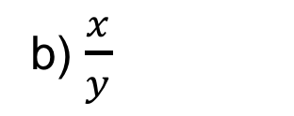
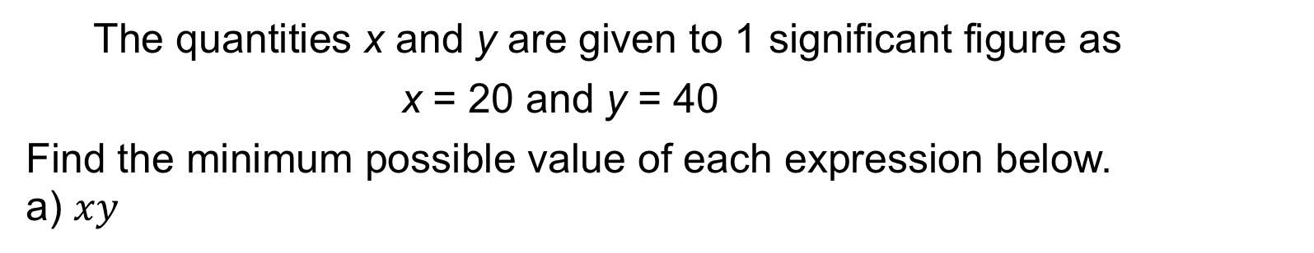
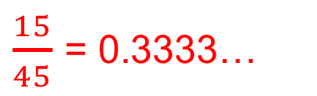
UNIT:
Units of Measurement
Section 2
Upper and Lower Bounds: Example
The quantities x and y are given to 1 significant figure as
x = 20 and y = 40
Find the minimum possible value of each expression below.
a) $xy$
x and y are given to 1 significant figure as x = 20 and y = 40 ,
so the ranges are:
15 ≤ x < 25 and 35 ≤ y < 45
The minimum possible value is 15 × 35 = 525
b) $\frac{x}{y}$
The smallest value is now obtained by dividing the lower bound by the
upper bound, as dividing by a bigger number gives a smaller answer.
$\frac{15}{45}$ = 0.3333…

Slide 16
UNIT:
Units of Measurement
Section 2
Section 2: Fitness Check
Here are some questions to check your progress;
there are more practice questions if needed.
For each quantity below, state the range of values within which it must lie.
a) x = 4.7
b) r = 11.68
c) w = 218
d) v = 20.0
    4.65 ≤ x < 4.75
      11.675 ≤ r <11.685
        217.5 ≤ w < 218.5
        19.95 ≤ v < 20.05

Slide 17
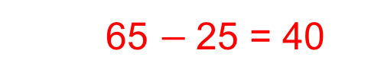
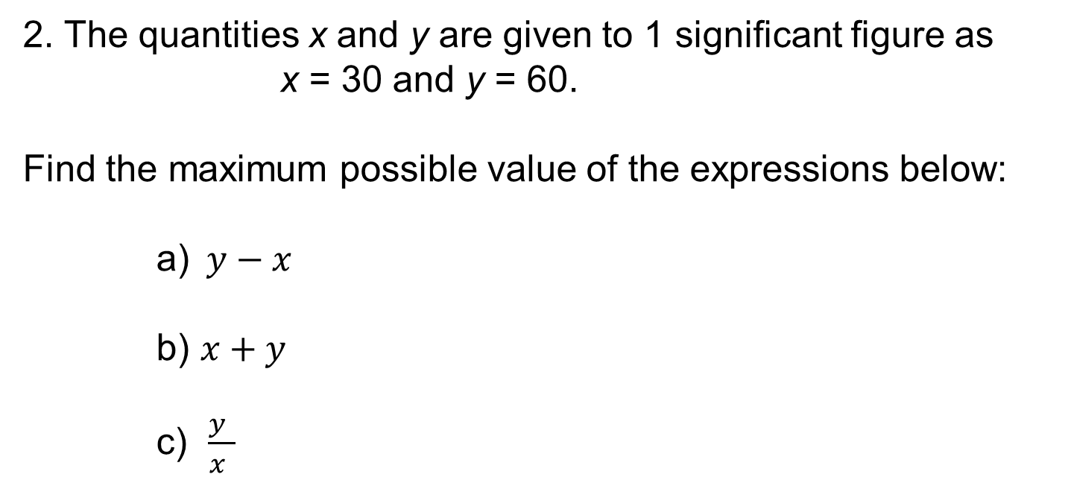
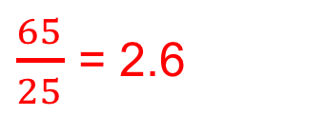
UNIT:
Units of Measurement
Section 2
Measurement Section 2: Fitness Check
2. The quantities x and y are given to 1 significant figure as
x = 30 and y = 60.
Find the maximum possible value of the expressions below:
a) $y−x$
b) $x+y$
c) $\frac{y }{x }$
  65 $−$25 = 40
65 + 35 = 100
$\frac{65}{25}$ = 2.6

Slide 18
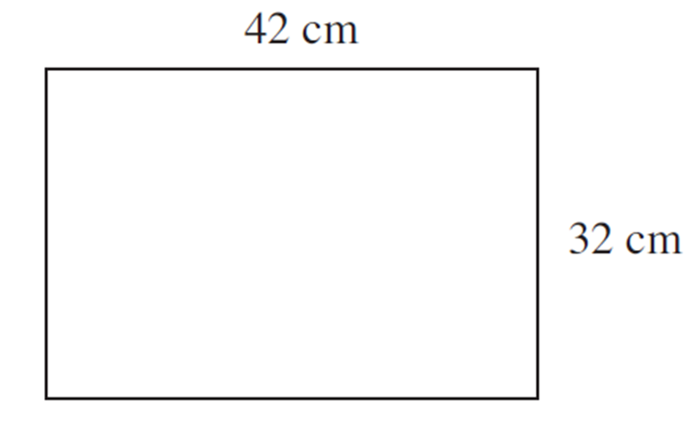
UNIT:
Units of Measurement
Section 2
Section 2: Fitness Check
3. If the length of the sides of the rectangle are given to
the nearest cm, find:
the maximum possible area
(b) the range of possible perimeters.
43.5 × 32.5 = 1413.75 cm²
148 cm ≤ perimeter < 152 cm

Slide 19
UNIT:
Units of Measurement
Section 2
Section 2: Review
You have completed the second Section.
If you have completed and understood this section,
click to start the next Section
If you need more examples and interactive practice,
press here
You might also find it helpful to look at:
Essential Information: press here

Slide 20
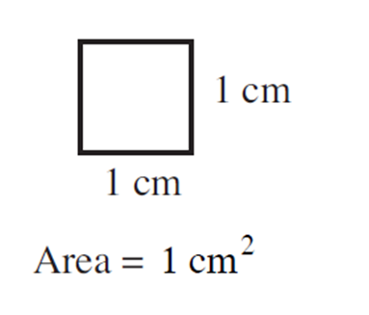
UNIT:
Units of Measurement
Section 3
Areas Concept
A square with sides of 1 cm has an area of 1 cm²
The area of shapes can be either counted or estimated to see how many of these squares fit inside the shape.
The next examples illustrate this method.

Slide 21
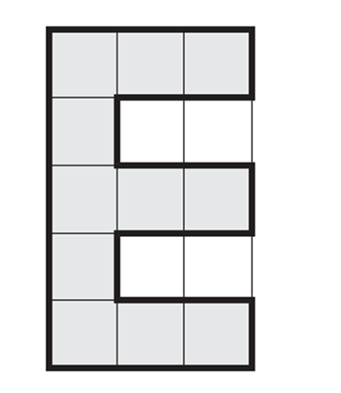
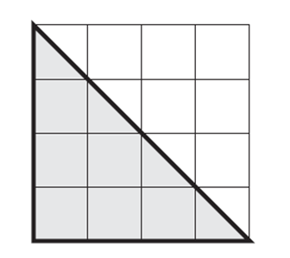
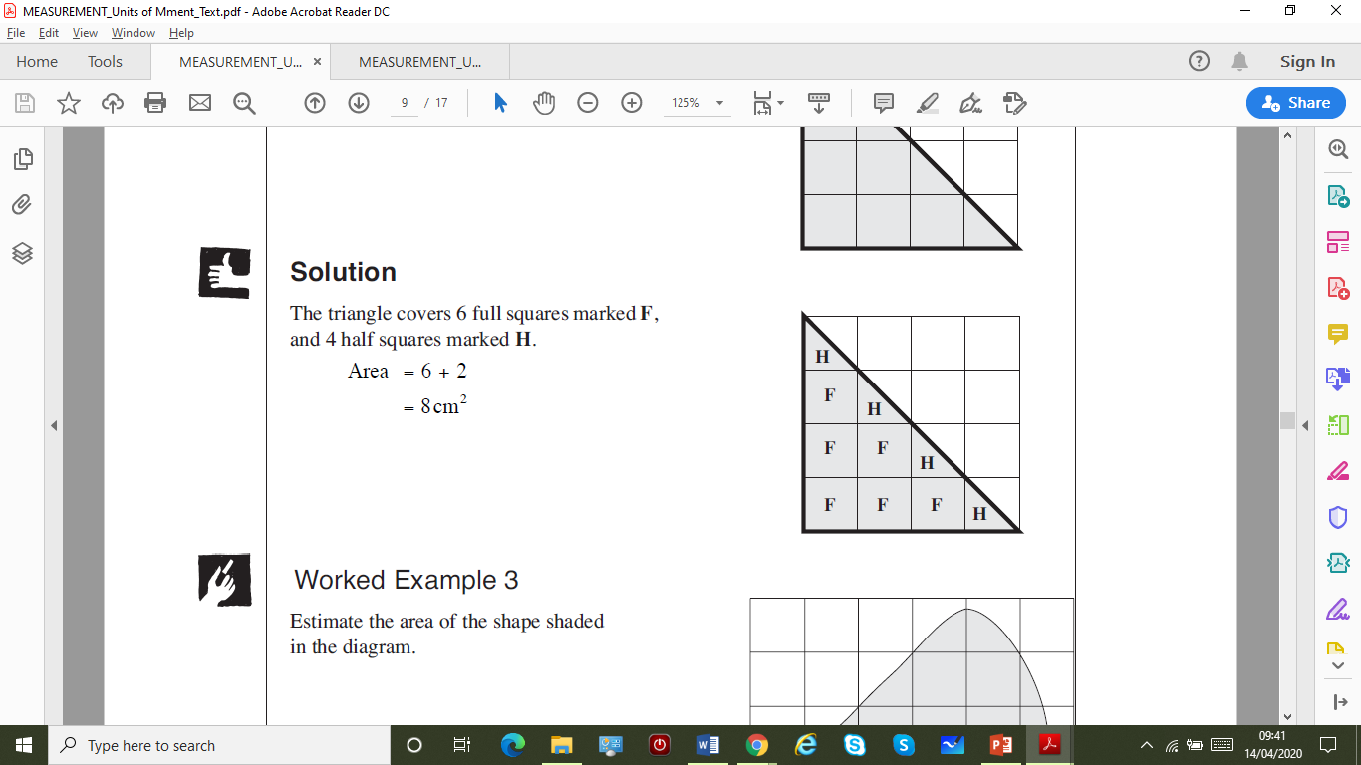
UNIT:
Units of Measurement
Section 3
Areas of Shapes: Examples
Example 1
Find the area of the shaded shape.
Solution
The shape covers 11 squares,
so its area is 11 cm²
Example 2
Find the area of the
shaded shape.
Solution
The triangle covers 6 full squares marked F, and 4 half squares marked H, the half squares combine to give an area of 2.
Area = 6 + 2 = 8 cm²

Slide 22
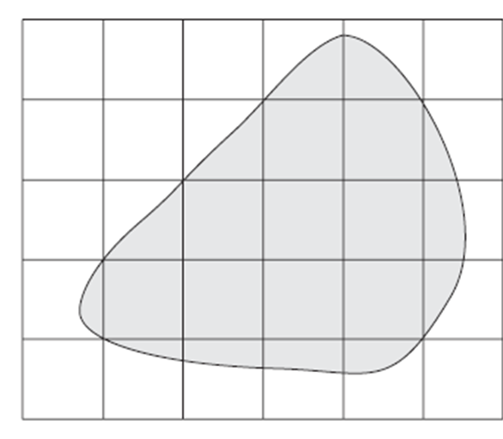
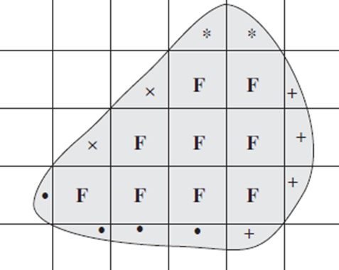
UNIT:
Units of Measurement
Section 3
Areas of Shapes: Examples
Example 3
Estimate the area of the shaded shape
Solution
This is a more complicated problem as there are only 9 full squares marked F, but many other part squares. You need to combine part squares that approximately make a whole square, as shown below.
Note that squares marked
* or × or + or • make about
1 full square; so this gives:
approximate area = 9 + 4 = 13 cm²

Slide 23
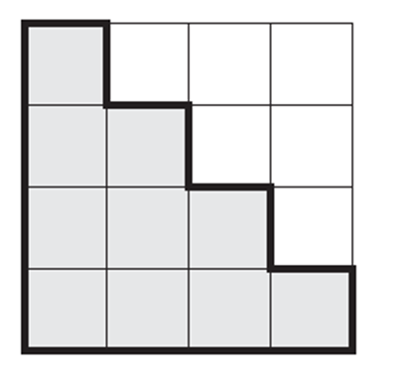
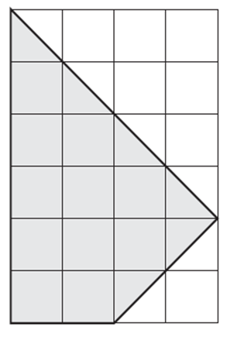
UNIT:
Units of Measurement
Section 3
Section 3: Fitness Check
1. Find the area of the shaded shape.
Answer
10 cm²
2. Find the area of the shaded shape.
Answer
14 cm²

Slide 24
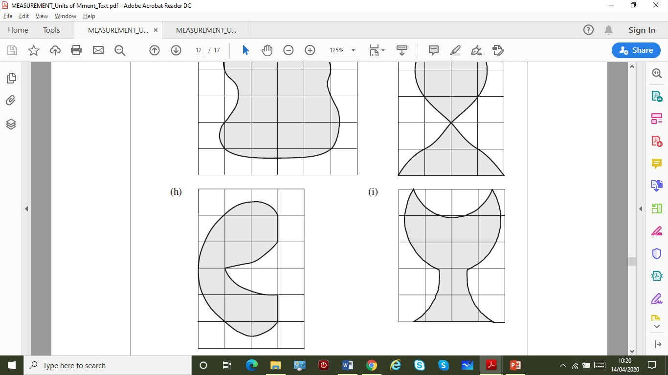
UNIT:
Units of Measurement
Section 3
Section 3: Fitness Check
3. Estimate the area of the shape
shaded in the diagram.
Answer
You should get an estimate
somewhere between
9 cm² and 11 cm²

Slide 25
UNIT:
Units of Measurement
Section 3
Section 3: Review
You have completed the third Section.
If you have completed and understood this section,
click to start the next Section
If you need more examples and interactive practice,
press here
You might also find it helpful to look at:
Essential Information: press here

Slide 26
UNIT:
Units of Measurement
Section 4
Conversion of Units
It is useful to be aware of both metric and imperial units and to be able to convert between them.
The following table shows conversions within
imperial units of measurement.
1 foot = 12 inches
1 yard = 3 feet
1 mile = 1760 yards
1 pound (lb) = 16 ounces
1 stone = 14 pounds
1 gallon = 8 pints

Slide 27
UNIT:
Units of Measurement
Section 4
Conversion of Units
You can convert between metric and imperial units using the following facts.
Conversion Facts
1 kg is about 2.2 lbs.
1 gallon is about 4.5 litres.
1 litre is about 1.75 pints.
5 miles is about 8 km.
1 inch is about 2.5 cm.
1 foot is about 30 cm.

Slide 28
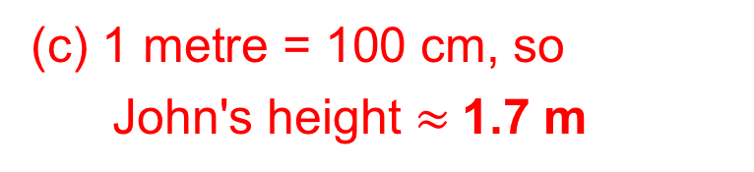
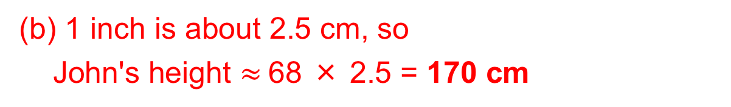
UNIT:
Units of Measurement
Section 4
Conversion of Units: Examples
Example 1
John is measured. His height is 5 feet and 8 inches.
Find his height in:
(a) inches (b) centimetres (c) metres
Solutions
There are 12 inches in one foot, so
John's height = 5×12 + 8 = 60 + 8 = 68 inches
(b) 1 inch is about 2.5 cm, so
John's height $≈$68 × 2.5 = 170 cm
(c) 1 metre = 100 cm, so
John's height $≈$1.7 m

Slide 29
UNIT:
Units of Measurement
Section 4
Conversion of Units: Examples
Example 2
A family travels 65 miles on holiday. Convert this distance to km.
Solution
As 5 miles is approximately equal to 8 km, first divide by 5 and then multiply by 8.
65 ÷ 5 = 13
13 × 8 = 104
So 65 miles is approximately the same as 104 km.
Example 3
A line is 80 cm long. Convert this length to inches.
Solution
1 inch = 2.5 cm
80 / 2.5 = 32, so the line is about 32 inches long.

Slide 30
UNIT:
Units of Measurement
Section 4
Conversion of Units: Examples
Example 4
John weighs 8 stone and 5 pounds. Find John's weight in:
(a) pounds (b) kg
Solution
There are 14 pounds in 1 stone, so
John's weight = 8 × 14 + 5
= 112 + 5
= 117 lbs
(b) As 1 pound is about 0.45 kg,
John's weight = 117 × 0.45
= 53 kg (to the nearest kg)

Slide 31
UNIT:
Units of Measurement
Section 4
Section 4: Fitness Check
Here are some questions to check your progress;
there are more practice questions if needed.
1. Convert each quantity to the units given.
3 inches to cm (b) 18 stone to pounds
(c) 6 lbs to ounces (d) 6 feet 3 inches to inches
(e) 15 kg to lbs (f) 3 yards to inches
(g) 3 feet to cm (h) 5 gallons to litres
(i) 45 kg to lbs (j) 9 litres to pints
(l) 45 gallons to litres (m) 8 litres to pints
7.5 cm
96 ounces
33 lbs
90 cm
99 lbs
202.5 litres
252 pounds
75 inches
108 inches
22.5 litres
15.75 pints
14 pints

Slide 32
UNIT:
Units of Measurement
Section 4
Section 4: Fitness Check
2. Convert each quantity to the units given.
Give answers to 1 decimal place.
3.6 kg
9.1 litres
13.3 feet
13.0 stones
7.0 feet
8 lbs to kg (b) 3 lbs to kg
(c) 16 pints to litres (d) 10 cm to inches
(e) 400 cm to feet (f) 80 ounces to pounds
(g) 182 lbs to stones (h) 50 litres to gallons
84 inches to feet (j) 52 cm to inches
1.4 kg
4.0 inches
5.0 lbs
11.1 gallon
20.8 inches

Slide 33
UNIT:
Units of Measurement
Section 4
Section 4: Fitness Check
3. Jimar is 6 feet 2 inches tall and weighs 11 stone 5 pounds.
Sam is 180 cm tall and weighs 68 kg.
Who is the taller and who is the heavier?
Find your answer by converting Jimar’s measurements
into metric measurements.
Answer
Jimar is both taller and heavier than Sam (Jimar is 185 cm tall and weighs over 70 kg).

Slide 34
UNIT:
Units of Measurement
Section 4
Section 4: Fitness Check
4. A car travels on average 10 km for every litre of fuel.
The car is driven from Chichester to Woking, a distance of 41 miles.
How far does the car travel in km?
(b) How many litres of fuel are used?
(c) How many gallons of fuel are used?
65.6 km
6.56 litres
1.46 gallons

Slide 35
UNIT:
Units of Measurement
Section 4
Section 4: Review
You have completed the fourth Section.
If you have completed and mastered this last section,
click here for the Unit audit
If you need more examples and interactive practice,
press here
You might also find it helpful to look at:
Essential Information: press here

